Slide 1
Threads in Java

Slide 2
Thread
Thread: single sequential flow of control within a program
Single-threaded program can handle one task at any time.
Multitasking allows single processor to run several concurrent threads.
Most modern operating systems support multitasking.

Slide 3
Advantages of Multithreading
Reactive systems – constantly monitoring
More responsive to user input – GUI application can interrupt a time-consuming task
Server can handle multiple clients simultaneously
Can take advantage of parallel processing

Slide 4
Different processes do not share memory space.
A thread can execute concurrently with other threads within a single process.
All threads managed by the JVM share memory space and can communicate with each other.

Slide 5

Threads Concept
Multiple threads on multiple CPUs
Multiple threads sharing a single CPU

Slide 6
Threads in Java
Creating threads in Java:
Extend java.lang.Thread class
OR
Implement java.lang.Runnable interface

Slide 7
Threads in Java
Creating threads in Java:
Extend java.lang.Thread class
  run() method must be overridden (similar to main method of sequential program)
  run() is called when execution of the thread begins
  A thread terminates when run() returns
  start() method invokes run()
  Calling run() does not create a new thread
Implement java.lang.Runnable interface

Slide 8
Threads in Java
Creating threads in Java:
Extend java.lang.Thread class
Implement java.lang.Runnable interface
  If already inheriting another class (i.e., JApplet)
  Single method: public void run()
  Thread class implements Runnable.

Slide 9
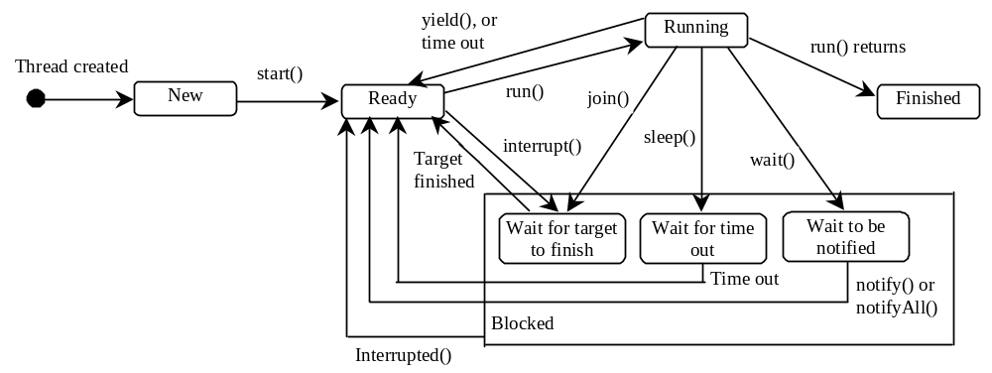
Thread States
A thread can be in one of five states: New, Ready, Running, Blocked, or Finished.

Slide 10
Thread termination
A thread becomes Not Runnable when one of these events occurs:
Its sleep method is invoked.
The thread calls the wait method to wait for a specific condition to be satisifed.
The thread is blocking on I/O.

Slide 11
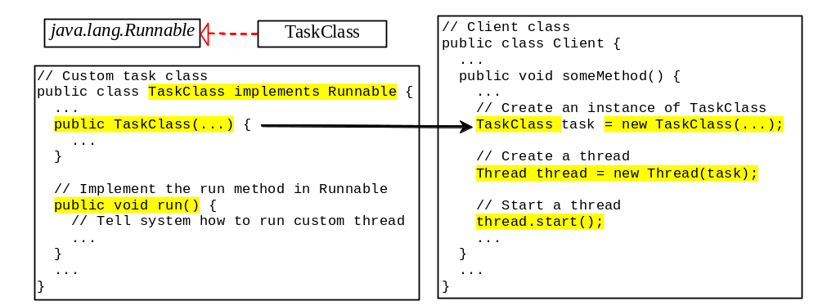
Creating Tasks and Threads

Slide 12
Example:
Using the Runnable Interface to Create and Launch Threads
Objective: Create and run three threads:
  The first thread prints the letter a 100 times.
  The second thread prints the letter b 100 times.
  The third thread prints the integers 1 through 100.

Slide 13
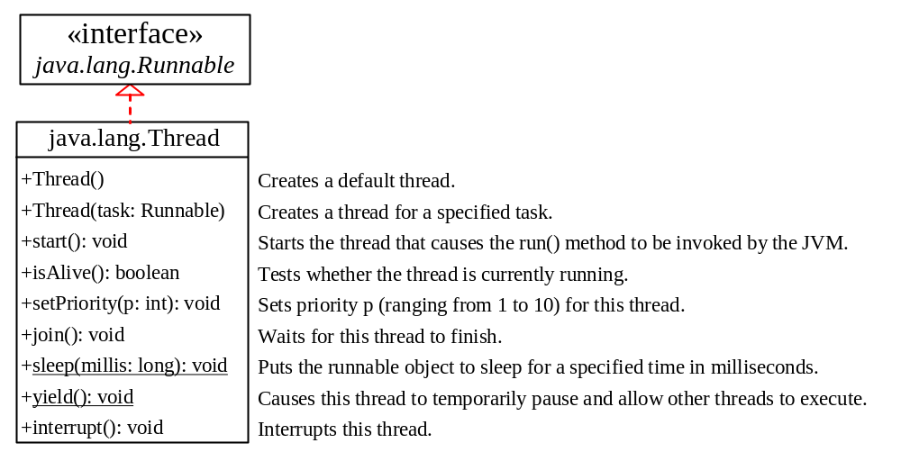
The Thread Class

Slide 14
The Static yield() Method
You can use the yield() method to temporarily release time for other threads. For example
  public void run() {
  for (int i = 1; i <= lastNum; i++) {
  System.out.print(" " + i);
  Thread.yield();
  }
  }
Every time a number is printed, the print100 thread is yielded. So, the numbers are printed after the characters.

Slide 15
The Static sleep(milliseconds) Method
The sleep(long mills) method puts the thread to sleep for the specified time in milliseconds. For example
  public void run() {
  for (int i = 1; i <= lastNum; i++) {
  System.out.print(" " + i);
  try {
  if (i >= 50) Thread.sleep(1);
  }
  catch (InterruptedException ex) {
  }
  }
  }
Every time a number (>= 50) is printed, the print100 thread is put to sleep for 1 millisecond.

Slide 16
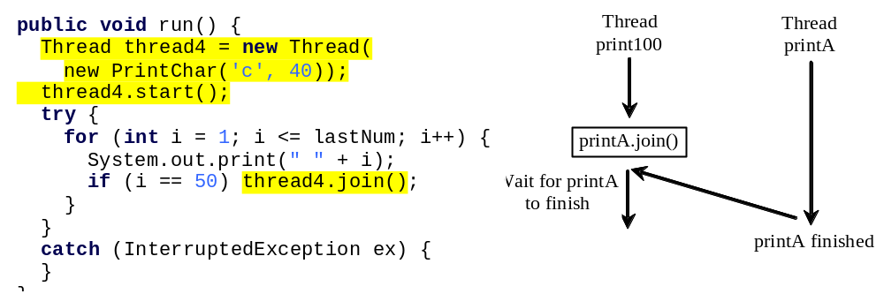
The join() Method
You can use the join() method to force one thread to wait for another thread to finish. For example, suppose you modify the code in Lines 53-57 in TaskThreadDemo.java as follows:
The numbers after 50 are printed after thread printA is finished.

Slide 17
Thread methods
isAlive()
method used to find out the state of a thread.
returns true: thread is in the Ready, Blocked, or Running state
returns false: thread is new and has not started or if it is finished.
interrupt()
f a thread is currently in the Ready or Running state, its interrupted flag is set; if a thread is currently blocked, it is awakened and enters the Ready state, and an java.io.InterruptedException is thrown.
The isInterrupt() method tests whether the thread is interrupted.

Slide 18
The deprecated stop(), suspend(), and resume() Methods
NOTE: The Thread class also contains the stop(), suspend(), and resume() methods. As of Java 2, these methods are deprecated (or outdated) because they are known to be inherently unsafe. You should assign null to a Thread variable to indicate that it is stopped rather than use the stop() method.

Slide 19
Thread Priority
Each thread is assigned a default priority of Thread.NORM_PRIORITY (constant of 5). You can reset the priority using setPriority(int priority).
Some constants for priorities include Thread.MIN_PRIORITY Thread.MAX_PRIORITY Thread.NORM_PRIORITY
By default, a thread has the priority level of the thread that created it.

Slide 20
Thread Scheduling
An operating system’s thread scheduler determines which thread runs next.
Most operating systems use timeslicing for threads of equal priority.
Preemptive scheduling: when a thread of higher priority enters the running state, it preempts the current thread.
Starvation: Higher-priority threads can postpone (possible forever) the execution of lower-priority threads.

Slide 21
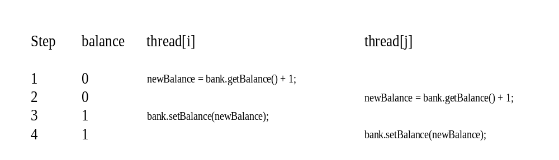
Thread Synchronization
A shared resource may be corrupted if it is accessed simultaneously by multiple threads.
Example: two unsynchronized threads accessing the same bank account may cause conflict.

Slide 22
Example
public class Counter{
private int count = 0;
public int getCount(){
return count;
}
public setCount(int count){
this.count = count;
}
}
In this example, the counter tells how many an access has been made.
If a thread is accessing setCount and updating count and another thread is accessing getCount at the same time, there will be inconsistency in the value of count.

Slide 23
Fixing the example
public class Counter{
private static int count = 0;
public synchronized int getCount(){
return count;
}
public synchoronized setCount(int count){
this.count = count;
}
}
By adding the synchronized keyword we make sure that when one thread is in the setCount method the other threads are all in waiting state.
The synchronized keyword places a lock on the object, and hence locks all the other methods which have the keyword synchronized. The lock does not lock the methods without the keyword synchronized and hence they are open to access by other threads.

Slide 24
What about static methods?
public class Counter{
private int count = 0;
public static synchronized int getCount(){
return count;
}
public static synchronized setCount(int count){
this.count = count;
}
}
In this example the methods are static and hence are associated with the class object and not the instance.
Hence the lock is placed on the class object that is, Counter.class object and not on the object itself. Any other non static synchronized methods are still available for access by other threads.

Slide 25
Common Synchronization mistake
public class Counter{
private int count = 0;
public static synchronized int getCount(){
return count;
}
public synchronized setCount(int count){
this.count = count;
}
}
The common mistake here is one method is static synchronized and another method is non static synchronized.
This makes a difference as locks are placed on two different objects. The class object and the instance and hence two different threads can access the methods simultaneously.

Slide 26
Object locking
The object can be explicitly locked in this way
  synchronized(myInstance){
  try{
  wait();
  }catch(InterruptedException ex){
  }
  System.out.println(“Iam in this “);
  notifyAll();
  }
  The synchronized keyword locks the object. The wait keyword waits for the lock to be acquired, if the object was already locked by another thread. Notifyall() notifies other threads that the lock is about to be released by the current thread.
  Another method notify() is available for use, which wakes up only the next thread which is in queue for the object, notifyall() wakes up all the threads and transfers the lock to another thread having the highest priority.

Slide 27
wait(), notify(), and notifyAll()
Use the wait(), notify(), and notifyAll() methods to facilitate communication among threads.
The wait(), notify(), and notifyAll() methods must be called in a synchronized method or a synchronized block on the calling object of these methods. Otherwise, an IllegalMonitorStateException would occur.
The wait() method lets the thread wait until some condition occurs. When it occurs, you can use the notify() or notifyAll() methods to notify the waiting threads to resume normal execution. The notifyAll() method wakes up all waiting threads, while notify() picks up only one thread from a waiting queue.

Slide 28
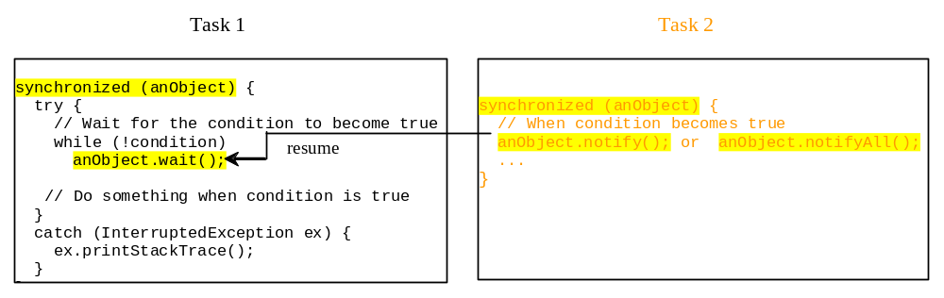
Example
The wait(), notify(), and notifyAll() methods must be called in a synchronized method or a synchronized block on the receiving object of these methods. Otherwise, an IllegalMonitorStateException will occur.
When wait() is invoked, it pauses the thread and simultaneously releases the lock on the object. When the thread is restarted after being notified, the lock is automatically reacquired.
The wait(), notify(), and notifyAll() methods on an object are analogous to the await(), signal(), and signalAll() methods on a condition.

Slide 29
Tutorial
http://www.deitel.com/articles/java_tutorials/20051126/JavaMultithreading_Tutorial_Part1.html

